Slide 1

OpenCPS Training – Development Team

Slide 2


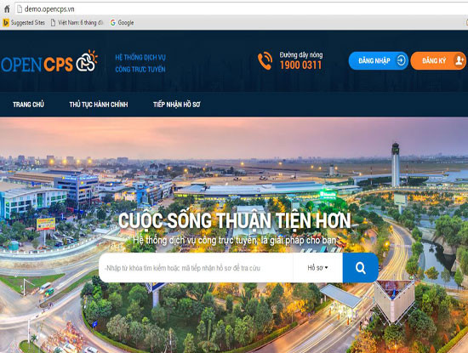


Tổng quan
Java + Ant + Eclipse
Source Code (Github)
Opencps-portlet.war Opencps-hook.war
Opencps-theme.war …
1.5
+
Liferay bundle with Jboss 6.2.5GA6

Slide 3
Các bước triển khai
Cài đặt Oracle JDK 7u79, Ant 1.9.7, MariaDB 10.1
Tải Liferay Bundle with Jboss 7.1.3
Git Clone OpenCPS và Tải Liferay Plugin SDK 6.2
Sử dụng Ant để Build Service * * *
Import OpenCPS Database
Cấu hình Liferay Bundle with Jboss 7.1.3
Start

Slide 4


Cài đặt Oracle JDK, Ant, MariaDB
Oracle JDK 7u79
MariaDB 10.1
Ant 1.9.7

Slide 5

2. Tải Liferay bundle with Jboss
/opt/server
Liferay bundle with Jboss 6.2.5GA6

Slide 6

3. Git Clone OpenCPS và Tải Liferay Plugin SDK
/opt/opencps
Liferay Plugin SDK 6.2
Source Code (Github)
1.5

Slide 7
4. Sử dụng Ant để Build Service * * *
Cấu hình Build.properties:
Sửa dòng 341 trong /opt/opencps/build.properties thành như sau:
ivy.jar.url=https://repository.liferay.com/nexus/content/repositories/liferay-public-snapshots/com/liferay/org.apache.ivy/${ivy.version}/org.apache.ivy-${ivy.version}.jar‘
- Tải Library sử dụng cho việc Build Service Link /opt/opencps/portlets/opencps-portlet/docroot/WEB-INF/lib/

Slide 8
4. Sử dụng Ant để Build Service * * *
Tao Build.[user].properties trong /opt/opencps/
app.server.type = jboss
app.server.parent.dir = /opt/server
app.server.jboss.dir = ${app.server.parent.dir}/jboss-7.1.3
app.server.jboss.deploy.dir = ${app.server.jboss.dir}/deploy
app.server.jboss.lib.global.dir = ${app.server.jboss.dir}/modules/comliferay/portal/main app.server.jboss.portal.dir = ${app.server.jboss.dir}/standalone/deployments/ROOT.war
javac.encoding = UTF-8

Slide 9
4. Sử dụng Ant để Build Service * * *
- Thứ tự Build Service:
Accountmgt Datamgt Processmgt Paymentmgt | 5. Dossiermgt 6. Servicemgt 7. Usermgt 8. Api

Slide 10
4. Sử dụng Ant để Build Service * * *
cp -rf /opt/opencps/portlets/opencps-portlet/docroot/WEB-INF/src/org/opencps/accountmgt/dao/service.xml /opt/opencps/portlets/opencps-portlet/docroot/WEB-INF/
ant -buildfile /opt/opencps/portlets/opencps-portlet/build.xml build-service
\cp -rf /opt/opencps/portlets/opencps-portlet/docroot/WEB-INF/src/org/opencps/datamgt/dao/service.xml /opt/opencps/portlets/opencps-portlet/docroot/WEB-INF/
ant -buildfile /opt/opencps/portlets/opencps-portlet/build.xml build-service
…

Slide 11
4. Sử dụng Ant để Build Service * * *
- Deploy file War:
ant -buildfile /opt/opencps/portlets/opencps-portlet/build.xml compile
ant -buildfile /opt/opencps/portlets/opencps-portlet/build.xml build-taglib
ant -buildfile /opt/opencps/portlets/opencps-portlet/build.xml deploy
ant -buildfile /opt/opencps/hooks/build.xml deploy
ant -buildfile /opt/opencps/themes/build.xml deploy
Opencps-portlet.war Opencps-hook.war
Opencps-theme.war
Opencps-ux-theme.war
/opt/server/deploy

Slide 12
5. Import OpenCPS Database và Init Data
db_script/opencps_v1.5.sql.tar.gz
[mysqld]
lower_case_table_names=1
Source Code (Github)
1.5
db_script/data.tar
C:\server\data

Slide 13
6. Cấu hình Liferay Bundle with Jboss
Kết nối đến Database:
Tạo file /opt/server/portal-setup-wizard.properties
admin.email.from.address=test@liferay.com
admin.email.from.name=Test Test
jdbc.default.driverClassName=com.mysql.jdbc.Driver
jdbc.default.password=ABCD1234
jdbc.default.url=jdbc:mysql://localhost/opencps?useUnicode=true&characterEncoding=UTF-8&useFastDateParsing=false
jdbc.default.username=root
liferay.home=/opt/server
setup.wizard.enabled=false
company.default.locale=vi_VN

Slide 14
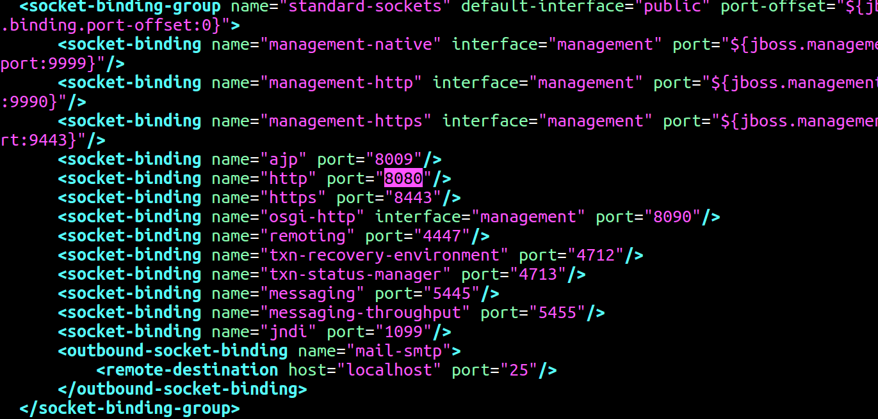
6. Cấu hình Liferay Bundle with Jboss
Cấu hình Port Web:
C:\server\jboss-7.1.3\standalone\configuration\standalone.xml

Slide 15
7. Start Jboss
Vào thư mục /opt/server/jboss-7.1.3/bin/
Linux | Window (cmd)
./startup.sh Hoặc ./standalone.sh | Standalone.bat

